Slide 1
TESTING HARDWARE PART -1
SUBMITTED BY – AMANDEEP SINGH C0761298
GROUP -2
SUBMITTED TO –MIKE ALESHAMS

Slide 2
Project Title: IOT based Bank Locker Security

Slide 3
COMPONENTS TESTED IN THIS PART:
BEGLEBONE BLACK
ARDUINO MEGA
SERVO MOTOR
GSM MODULE
VIBRATION SENSOR

Slide 4
ARDUINO IDE
Cross platform for application for Linux , windows and macOS.
Used to write and upload codes to Arduino boards of all kinds.
Also compatible with other third-party cores and vendor development boards.
The Arduino IDE supports the languages C and C++ using special rules of code structuring.
The Arduino IDE supplies a software library from the Wiring project, which provides many common input and output procedures.
User-written code only requires two basic functions, for starting the sketch and the main program loop, that are compiled and linked with a program stub main() into an executable cyclic executive program with the GNU toolchain, also included with the IDE distribution

Slide 5
Arduino ide (continued)
The Arduino IDE employs the program avrdude to convert the executable code into a text file in hexadecimal encoding that is loaded into the Arduino board by a loader program in the board's firmware.
Build in examples are provided for number of boards that can be easily accessed by connecting the development board with the host machine.

Slide 6
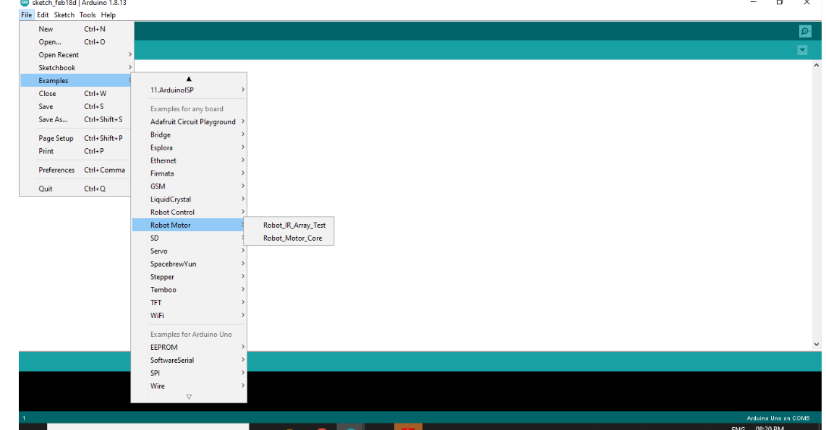

Slide 7
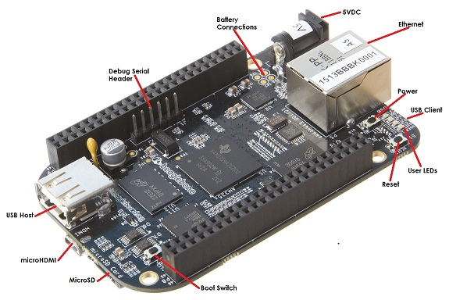
Beaglebone Black

Slide 8
Beaglebone black
DC power is the main DC input that accepts 5V power.
Power Button alerts the processor to initiate the power down the sequence and is used to power the board.
BOOT switch can be used to force a boot from the microSD card if the power is cycled on the board, removing power and reapplying the power to the board.
Reset Button allows the user to reset the processor.
MicroSD slot is where a microSD card can be installed.
Micro HDMI connector is where the display is connected to.
USB Host can connected different USB interfaces such as Wi-Fi ,BT , Keyboards, etc.

Slide 9
Testing Beaglebone
There are various commands available that can be used to determine the functioning of BeagleBone Black.
The ls -l command determines the list of all files present in the beaglebone.
uname -a determines the latest version of the debian image.
The command put -r <folder name>/<file name> is used to upload the any folder or file on the beaglebone black.

Slide 10
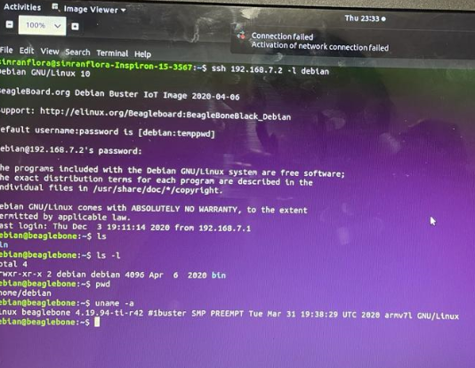
Testing ON LINUX command line

Slide 11
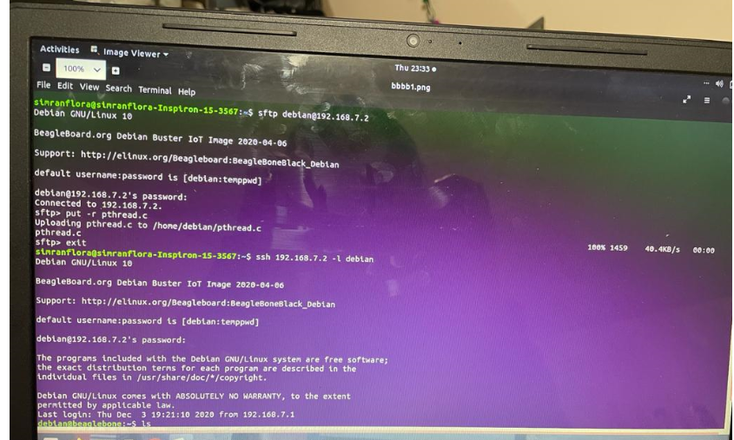
testing

Slide 12
Arduino Mega
The Arduino Mega is a microcontroller board based on the ATmega2560. It has 54 digital input/output pins (of which 14 can be used as PWM outputs), 16 analog inputs, 4 UARTs (hardware serial ports), a 16 MHz crystal oscillator, a USB connection, a power jack, an ICSP header, and a reset button.
Used as a slave device in our project mainly to interface the fingerprint sensor and gsm module.

Slide 13
Testing Arduino Mega
To test this device we need to connect the board to the host machine.
Testing is mainly done with the help of Arduino IDE
We can run any of the example available for this board
In Arduino IDE we have used basic examples like Blink and Fade to check the Board.

Slide 14
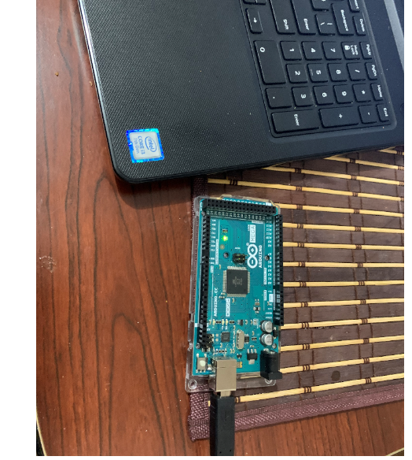
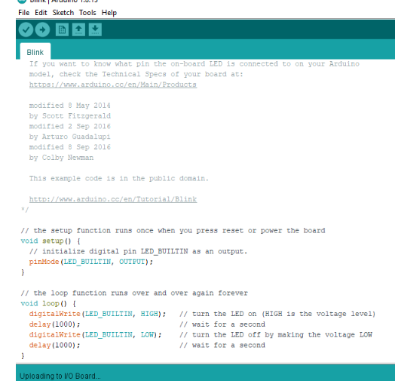

Slide 16
Testing servo motor
Task is performed using the Arduino.
Servo motor can be directly connected to the Arduino.
servo motors are used to control the position of objects, rotate objects,
Hardware requirements for this task are
1 TowerPro SG90 servo motor
1 Arduino Mega2560
3 jumper wires

Slide 17
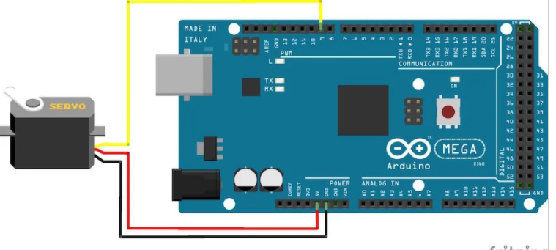
WIRING
Servo red wire – 5V pin Arduino
Servo brown wire – Ground pin Arduino
Servo yellow wire – PWM(9) pin Arduino

Slide 18
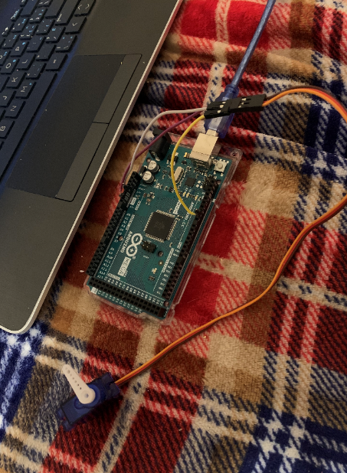
After connecting the components the Arduino board is connected to the host machine .
Then the code is saved and imported into the Arduino board.

Slide 19
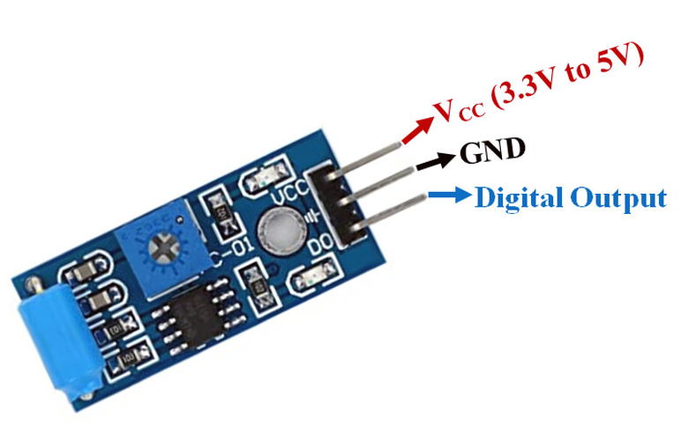
Testing vibration sensor
Hardware required
Arduino
Vibration sensor
Wires
Led
Diode(330ohm)

Slide 20
Connecting all devices
connect the D0 pin of the sensor with pin number 9 of the Arduino
connect the ground pin of the sensor with the ground pin of the Arduino.
connect Vcc of the vibration sensor with the Arduino’s 5v.
connect a 330-ohm resistor on the anode side of the led, this is a current limiting resistor.
connect the cathode side of the led with the Arduino’s ground.
connect the anode side of the led with pin number 13.

Slide 21
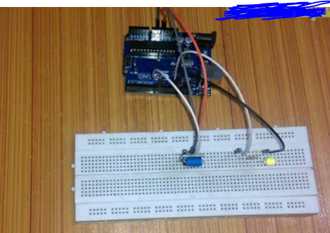

Slide 22
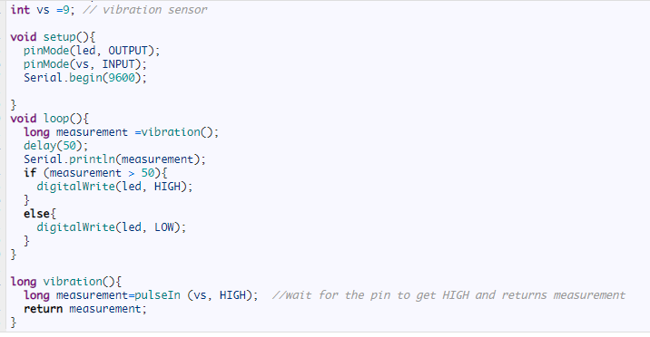
Arduino Ide code

Slide 23
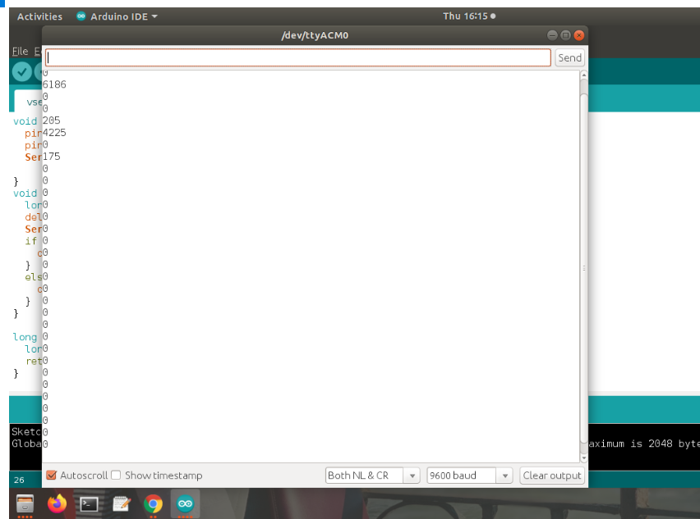
Output on IDE

Slide 24
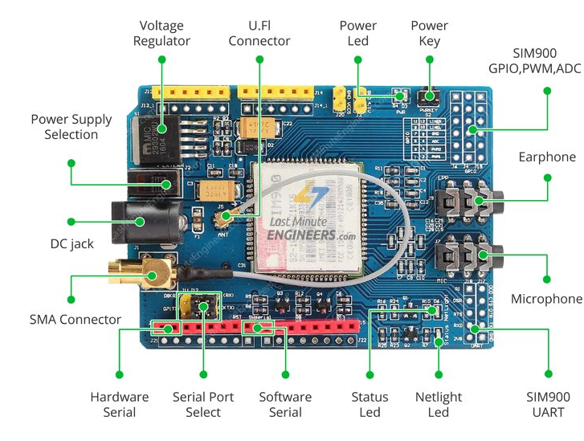
GSM Module

Slide 25
Features
Send and receive SMS.
Place and receive phones calls.
Led status indicator: 3 different LED tells about the power connectivity or signal connectivity.
PWR: Connected to shield power supply. It is on when power adaptor is connected.
Status: Indicate the Chip is in working status.
Netlight: Status of cellular network.

Slide 26
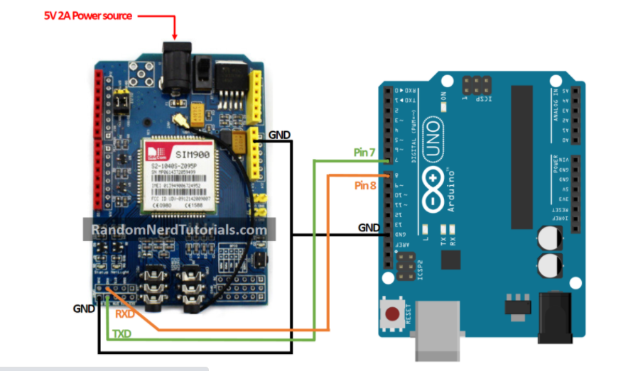
Testing

Slide 27
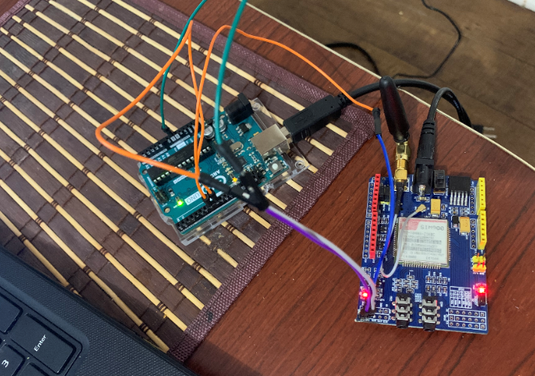

Slide 28
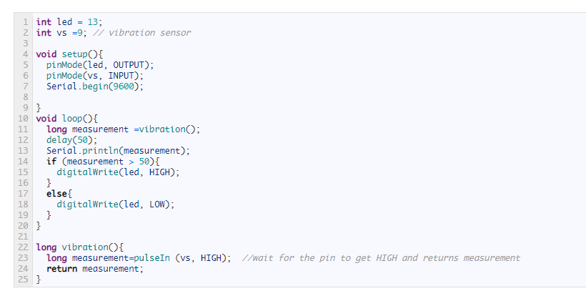
Code for sending SMS

Slide 29
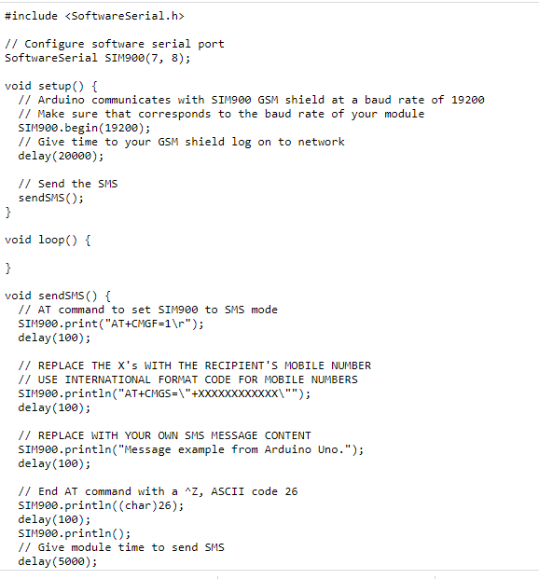
Code for sending SMS

Slide 30
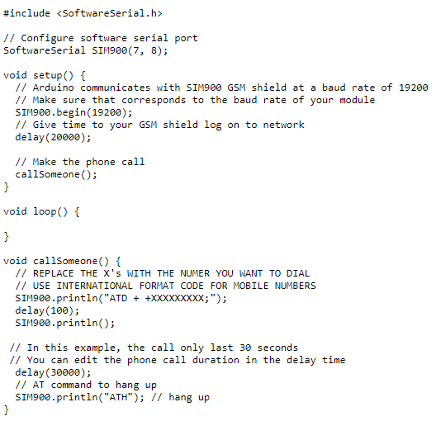
Code for Calling

Slide 31
References
Testing servomotor:
https://www.allaboutcircuits.com/projects/servo-motor-control-with-an-arduino/
Testing vibration senor:
http://www.electroniclinic.com/vibration-sensor-tutorial-vibration-measurement-vibration-detector-sw-420/
Testing GSM
https://randomnerdtutorials.com/sim900-gsm-gprs-shield-arduino/

Slide 32
refrences
For Arduino ide
https://www.arduino.cc/en/Tutorial/BuiltInExamples

